Slide 1
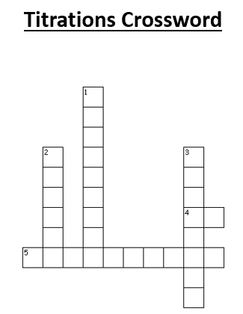
C4.8 Titration Calculations
Learning objectives:
To calculate number of moles or the mass of a solute in a given volume of known solution
Calculate the amount of acid or alkali needed for neutralisation
Calculate an unknown concentration for reaction volumes of two solutions. One with known concentration.
Starter:
Complete the crossword.

Slide 2
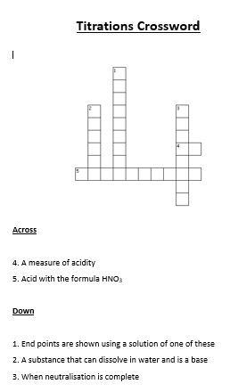
Notes:
Across
4. pH
5. Nitric
Down
Indicator
Alkali
End point

Slide 3
Concentration = no. of moles volume
Concentration in mol/dm³
Learn this formula triangle!
number of moles
n
concentration (in mol dm⁻³)
volume (in dm³)
c
v

Slide 4
Applying the formulae
Example 1:
What is the concentration of a solution with 2 moles of salt in 500cm³?
The question already tells us the number of moles and the volume, so use the formula:
c = n = 2 = 4 mol/dm³
v 0.5
convert the volume to dm³ first by dividing by 1000.
Notes:
White boards activity

Slide 5
Applying the formulae
Example 2:
How many moles of sodium chloride are in 250cm³ of a 3 mol dm⁻³ solution of sodium chloride?
The question tells us the volume and concentration, so use the formula:
n = c x v = 3 x 0.25 = 0.75 moles
convert the volume to dm³ first by dividing by 1000.

Slide 6
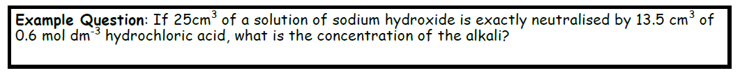

Slide 7
Applying this to titration calculations
“In a titration, 20 cm³ of 1.0 mol dm⁻³ hydrochloric acid, HCl, reacted with 25 cm³ of sodium hydroxide, NaOH. What was the concentration of the sodium hydroxide?”
You will need to write a balanced symbol equation.
Use the crib sheets available (2 options)

Slide 8
Applying this to titration calculations
“In a titration, 20 cm³ of 1.0 mol dm⁻³ hydrochloric acid, HCl, reacted with 25 cm³ of sodium hydroxide, NaOH. What was the concentration of the sodium hydroxide?”
 | Acid | Alkali
Ratio
n
v
c

Slide 9
Tasks
Complete the C4 L8 Titration calculations worksheet
Calculation sheet: Calculating chemical quantities in titrations.
Homework: Titration exam questions
Due:

Slide 10
Answers
Section A
1.6 mol dm⁻³
0.08 mol dm⁻³
0.12 mol dm⁻³
0.912 mol dm⁻³
Section B
1.6 mol dm⁻³
0.8 mol dm⁻³
2.4 mol dm⁻³
1.0 mol dm⁻³

Slide 11
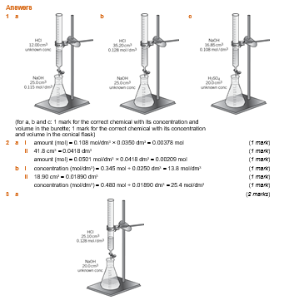

Slide 12
